Slide 1

Classical Kinematics (Geometric Approach)
by Sarot SRANG

Slide 2
Contents
Introduction
Actuators and Drive Systems
Kinematics of Mobile Robot
Kinematics
Control methods
Classical Kinematics (Geometric Approach)
2DOF manipulator
3DOF planar manipulator
4DOF spatial manipulator
Rotation matrix
Kinematics for Complex System (Algebraic Approach)
Homogeneous transformation and Denavit-Hartenberg parameters
5DOF and 6DOF spatial manipulator
Part II: Manipulator

Slide 3
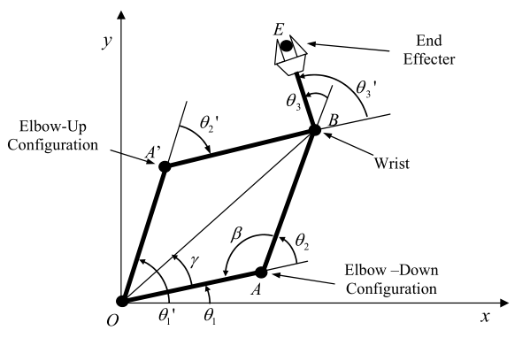




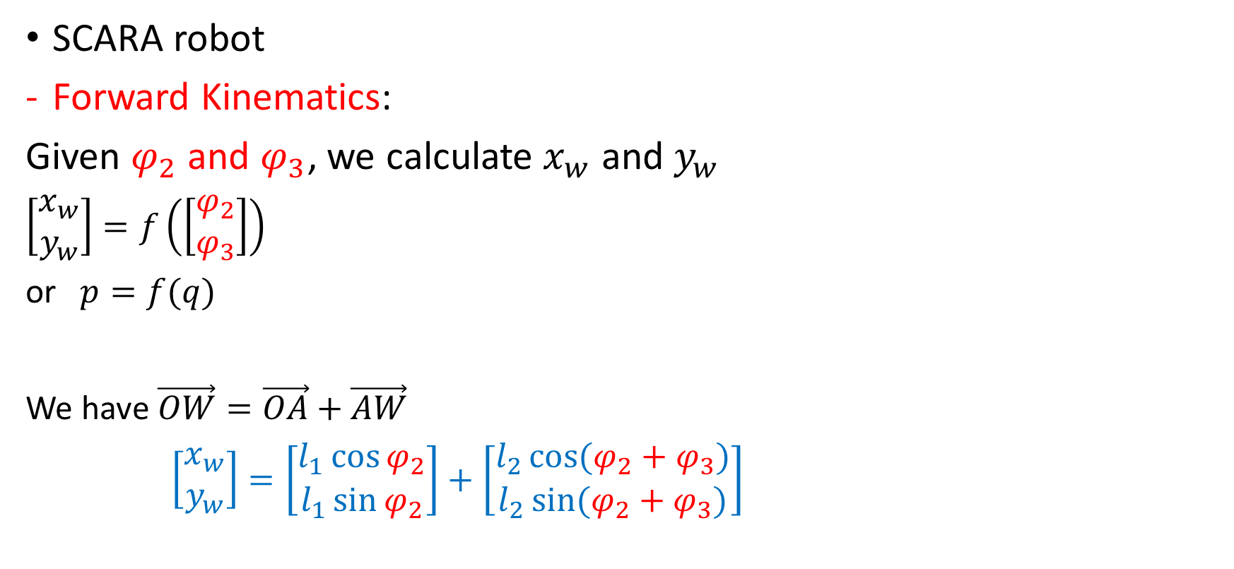





Classical Kinematics
SCARA robot
Forward Kinematics:
Given $φ_{2}$ and $φ_{3}$, we calculate $x_{w}$ and $y_{w}$
$\left[\begin{matrix}x_{w} \\ y_{w}\end{matrix}\right]=f\left(\left[\begin{matrix}φ_{2} \\ φ_{3}\end{matrix}\right]\right)$
or $p=f(q)$
We have $\vec{OW}=\vec{OA}+\vec{AW}$
$\left[\begin{matrix}x_{w} \\ y_{w}\end{matrix}\right]=\left[\begin{matrix}l_{1}\cos{φ_{2}} \\ l_{1}\sin{φ_{2}}\end{matrix}\right]+\left[\begin{matrix}l_{2}\cos{(φ_{2}+φ_{3})} \\ l_{2}\sin{(φ_{2}+φ_{3})}\end{matrix}\right]$
$$W$$
$${=φ′}_{3}$$
$${=φ}_{3}$$
$$l_{1}$$
$${=φ}_{2}$$
$$={φ′}_{2}$$
$$φ:Phi \\ φ:Varphi$$
Done!

Slide 4



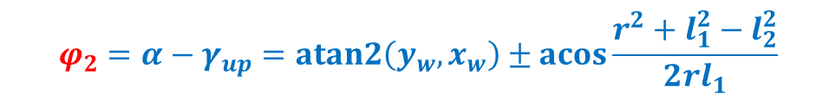




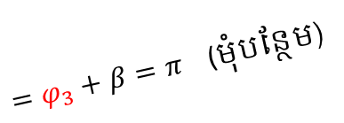

Classical Kinematics for SCARA robot
Inverse kinematics: Given $x_{w}$ and $y_{w}$, we
calculate $φ_{2}$ and $φ_{3}$ → $q=f^{−1}(p)$.
HOW ???
Find $α$ and $γ$ first !
$\tan{α}=\frac{y_{w}}{x_{w}}$, then $α=\operatorname{atan}{\frac{y_{w}}{x_{w}}}$ → easy, but
there is practical problem though!
$−\frac{π}{2}≤\operatorname{atan}{\frac{y_{w}}{x_{w}}}≤\frac{π}{2}$ not true if the point $W$ is
in the 2nd or 4th quadrant. So, in practice
we use $α=atan2{(y_{w},x_{w})}$ $(0≤α≤2π)$
-- Let $r=\sqrt{x_{w}^{2}+y_{w}^{2}}$. For $ΔOAW$, cosine theorem gives
$l_{2}^{2}=r^{2}+l_{1}^{2}−2rl_{1}\cos{γ}⇔γ=±\operatorname{acos}{\frac{r^{2}+l_{1}^{2}−l_{2}^{2}}{2rl_{1}}}$ (Elbow-Down and Elbow-Up)
$$W$$
$${=φ′}_{3}$$
$$l_{2}$$
$$=φ_{3}+β=π \text{(}\text{មុំបន្ថែម}\text{)}$$
$$l_{1}$$
$${=φ}_{2}$$
$$={φ′}_{2}$$
$$φ_{2}=α−γ_{up}=atan2\left(y_{w},x_{w}\right)±\operatorname{acos}{\frac{r^{2}+l_{1}^{2}−l_{2}^{2}}{2rl_{1}}}$$

Slide 5





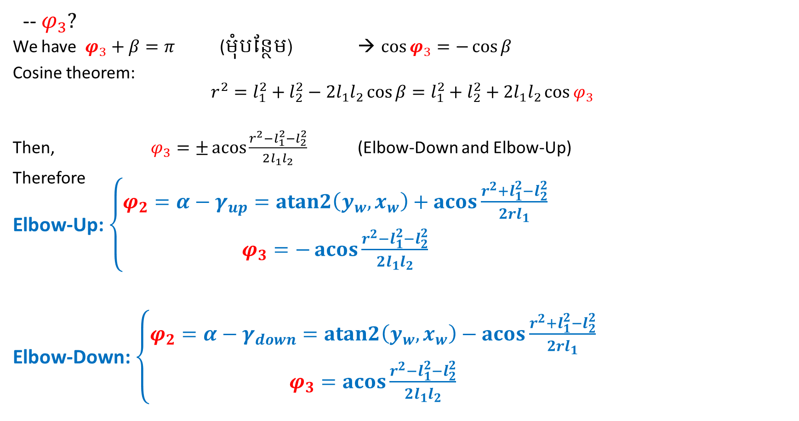
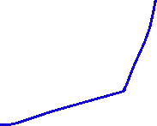
Classical Kinematics for SCARA robot
-- $φ_{3}?$
We have $φ_{3}+β=π$ (មុំបន្ថែម) → $\cos{φ_{3}}=−\cos{β}$
Cosine theorem:
$$r^{2}=l_{1}^{2}+l_{2}^{2}−2l_{1}l_{2}\cos{β}=l_{1}^{2}+l_{2}^{2}+2l_{1}l_{2}\cos{φ_{3}}$$
Then, $φ_{3}=±\operatorname{acos}{\frac{r^{2}−l_{1}^{2}−l_{2}^{2}}{2l_{1}l_{2}}}$ (Elbow-Down and Elbow-Up)
Therefore
Elbow-Up: $\left\{\begin{matrix}φ_{2}=α−γ_{up}=atan2\left(y_{w},x_{w}\right)+\operatorname{acos}{\frac{r^{2}+l_{1}^{2}−l_{2}^{2}}{2rl_{1}}} \\ φ_{3}=−\operatorname{acos}{\frac{r^{2}−l_{1}^{2}−l_{2}^{2}}{2l_{1}l_{2}}}\end{matrix}\right.$
Elbow-Down: $\left\{\begin{matrix}φ_{2}=α−γ_{down}=atan2\left(y_{w},x_{w}\right)−\operatorname{acos}{\frac{r^{2}+l_{1}^{2}−l_{2}^{2}}{2rl_{1}}} \\ φ_{3}=\operatorname{acos}{\frac{r^{2}−l_{1}^{2}−l_{2}^{2}}{2l_{1}l_{2}}}\end{matrix}\right.$

Slide 6





Classical Kinematics for SCARA robot
The inverse kinematics can be also defined as following
$\cos{φ_{3}=\frac{r^{2}−l_{1}^{2}−l_{2}^{2}}{2l_{1}l_{2}}}=D$.
Then $\sin{φ_{3}}=±\sqrt{1−D^{2}}$.
So
$φ_{3}=atan2{(±\sqrt{1−D^{2}},D)}$
($+$ Elbow-Down, $−$ Elbow-Up)
$φ_{2}=atan2{(y_{w},x_{w})}$
$−atan2{(l_{2}\sin{φ_{3}},l_{1}+l_{2}\cos{φ_{3}})}$
$$W$$
$${=φ′}_{2}$$
$$l_{2}$$
$${=φ}_{3}$$
$$l_{1}$$
$${=φ}_{2}$$
$$={φ′}_{1}$$

Slide 7
Algorithm fscara: Forward kinematics for SCARA Robot

Slide 8



Algorithm iscara: Inverse kinematics for SCARA Robot

Slide 9
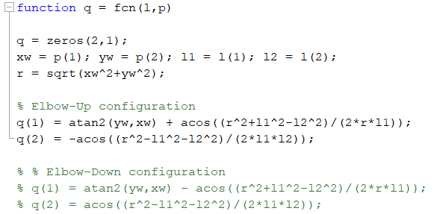

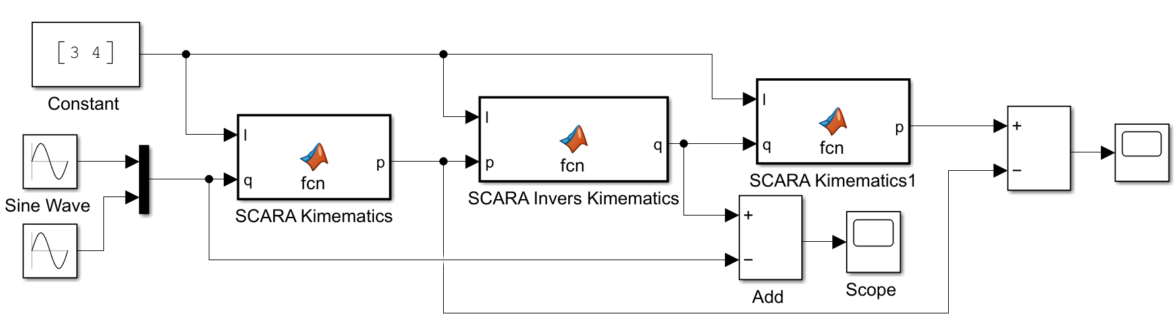
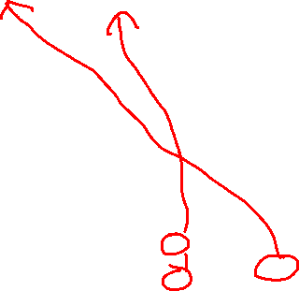
Classical Kinematics for SCARA robot (verifying the formula!)
Inverse Kinematics
Kinematics

Slide 10
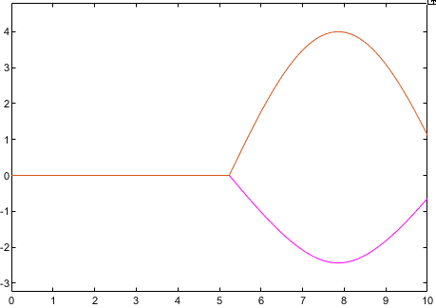
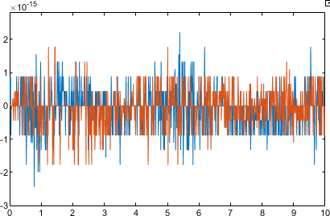
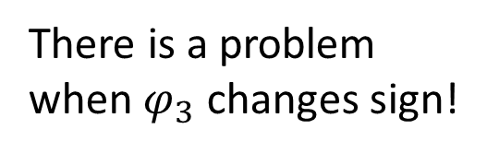



Classical Kinematics for SCARA robot
(Inverse Kinematics)
Ok!
(Kinematics)
There is a problem when $φ_{3}$ changes sign!
Not ok!
Why?
Error of $q$
Error of $p$

Slide 11













Classical Kinematics
3DOF planar manipulator
Forward Kinematics: Given $φ_{2}, φ_{3}$ and $φ_{4}$,
we calculate $x_{e}, y_{e}$ and $φ_{e}$
$\left[\begin{matrix}x_{e} \\ \begin{aligned}y_{e} \\ φ_{e}\end{aligned}\end{matrix}\right]=f\left(\left[\begin{matrix}φ_{2} \\ \begin{aligned}φ_{3} \\ φ_{4}\end{aligned}\end{matrix}\right]\right)$
or $p=f(q)$
We have $φ_{e}=φ_{2}+φ_{3}+φ_{4}$
and $\vec{OE}=\vec{OA}+\vec{AW}+\vec{WE}$
$\left[\begin{matrix}x_{e} \\ y_{e}\end{matrix}\right]=\left[\begin{matrix}l_{1}\cos{φ_{2}} \\ l_{1}\sin{φ_{2}}\end{matrix}\right]+\left[\begin{matrix}l_{2}\cos{(φ_{2}+φ_{3})} \\ l_{2}\sin{(φ_{2}+φ_{3})}\end{matrix}\right]+\left[\begin{matrix}l_{3}\cos{φ_{e}} \\ l_{3}\sin{φ_{e}}\end{matrix}\right]$ Done!
$${=φ′}_{3}$$
$$l_{3}$$
$$W$$
$$φ:Phi \\ φ:Varphi$$
$$l_{2}$$
$${=φ}_{3}$$
$$l_{1}$$
$${=φ}_{2}$$
$$={φ′}_{2}$$

Slide 12



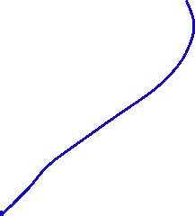
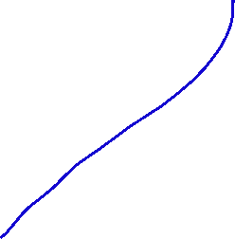

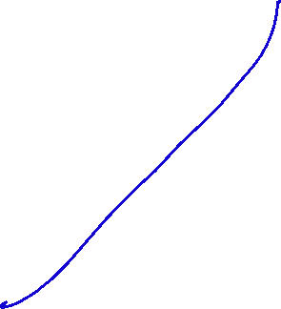


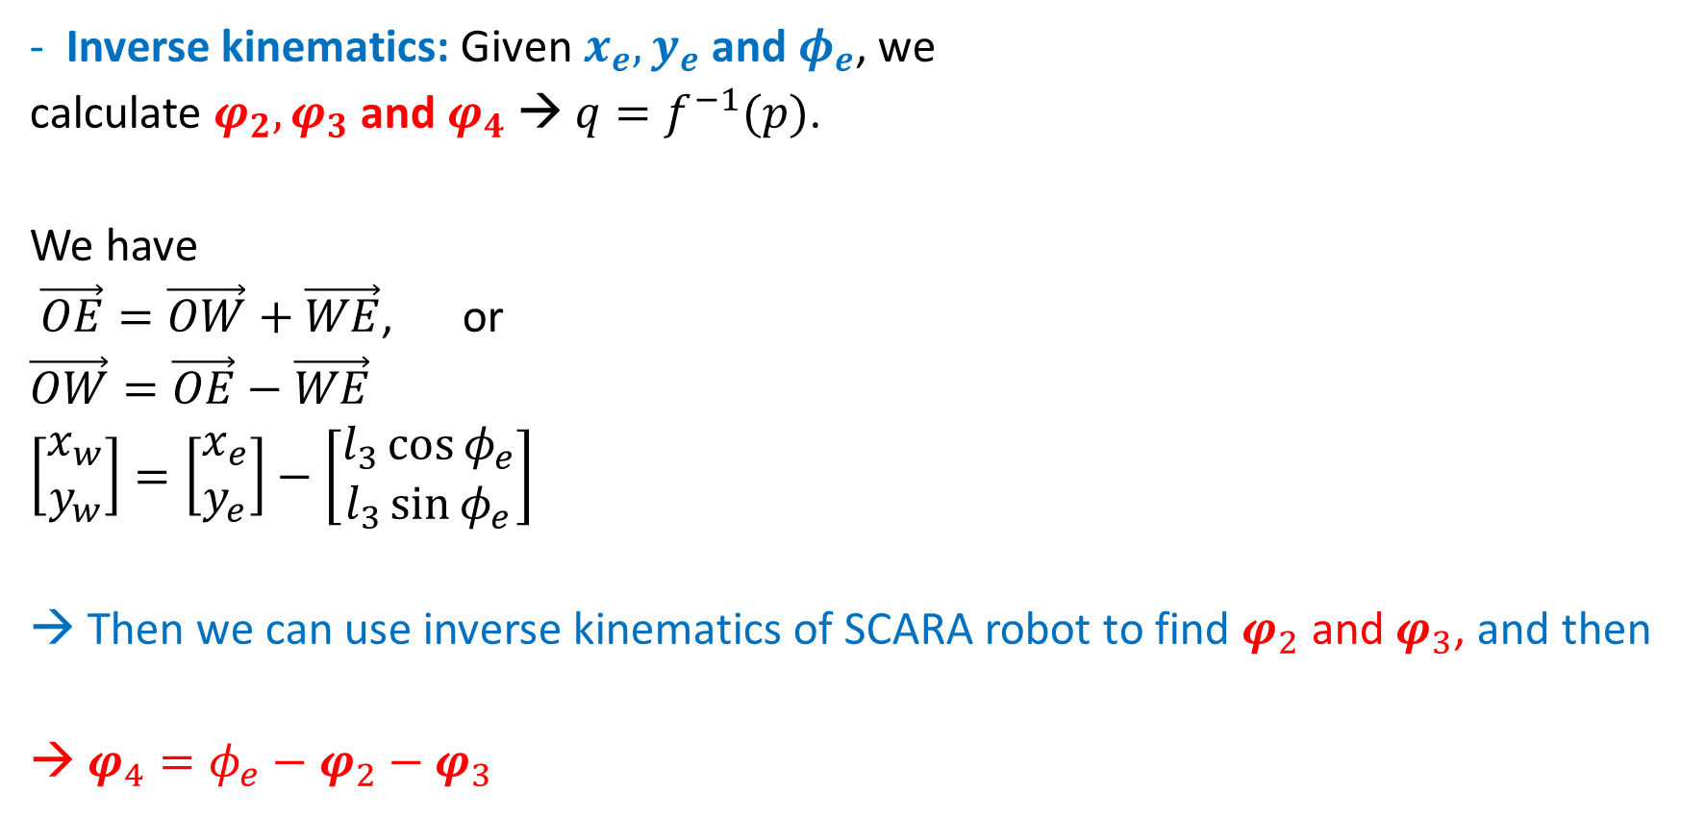


Classical Kinematics for 3DOF planar manipulator
Inverse kinematics: Given $x_{e}, y_{e}$ and $φ_{e}$, we
calculate $φ_{2}, φ_{3}$ and $φ_{4}$ → $q=f^{−1}(p)$.
We have
$\vec{OE}=\vec{OW}+\vec{WE}$, or
$\vec{OW}=\vec{OE}−\vec{WE}$
$\left[\begin{matrix}x_{w} \\ y_{w}\end{matrix}\right]=\left[\begin{matrix}x_{e} \\ y_{e}\end{matrix}\right]−\left[\begin{matrix}l_{3}\cos{φ_{e}} \\ l_{3}\sin{φ_{e}}\end{matrix}\right]$
→ Then we can use inverse kinematics of SCARA robot to find $φ_{2}$ and $φ_{3}$, and then
→ $φ_{4}=φ_{e}−φ_{2}−φ_{3}$
$$={φ′}_{4}$$
$$φ_{4}=$$
$${=φ′}_{3}$$
$$l_{3}$$
$$W$$
$$l_{2}$$
$${=φ}_{3}$$
$$l_{1}$$
$${=φ}_{2}$$
$$={φ′}_{2}$$

Slide 13
Algorithm f3dof: Forward kinematics for 3DOF Robot

Slide 14








Algorithm i3dof: Inverse kinematics for 3DOF Robot

Slide 15







Homework
Find equation of inverse kinematics of the two link robot arm as shown in the figure

Slide 16
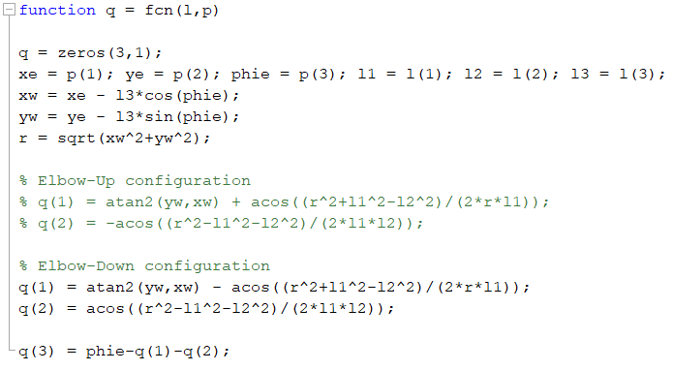
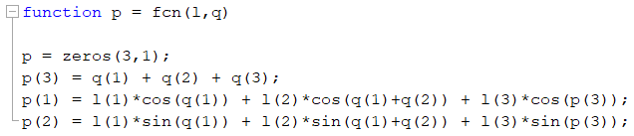
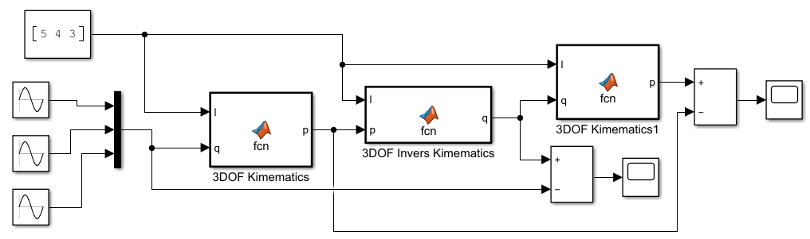
Inverse Kinematics
Verify!!!
Kinematics

Slide 17
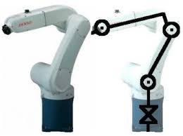

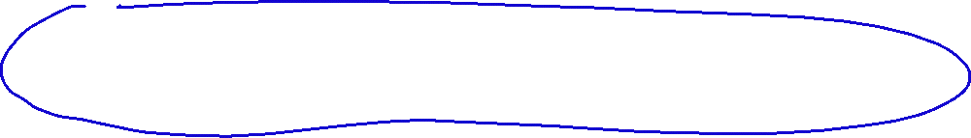









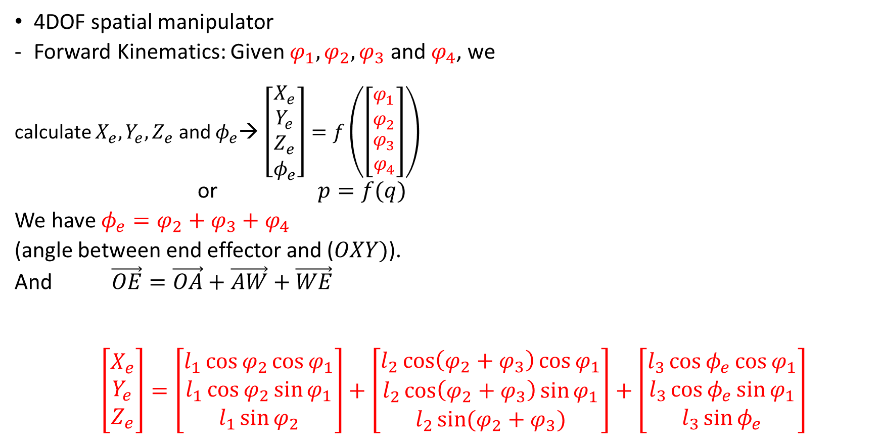


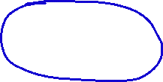














Classical Kinematics
4DOF spatial manipulator
Forward Kinematics: Given $φ_{1},φ_{2},φ_{3}$ and $φ_{4}$, we
calculate $X_{e}, Y_{e}, Z_{e}$ and $φ_{e}$→ $\left[\begin{matrix}X_{e} \\ \begin{aligned}Y_{e} \\ Z_{e} \\ φ_{e}\end{aligned}\end{matrix}\right]=f\left(\left[\begin{matrix}\begin{aligned}φ_{1} \\ φ_{2}\end{aligned} \\ \begin{aligned}φ_{3} \\ φ_{4}\end{aligned}\end{matrix}\right]\right)$
or $p=f(q)$
We have $φ_{e}=φ_{2}+φ_{3}+φ_{4}$
(angle between end effector and ($OXY)$).
And $\vec{OE}=\vec{OA}+\vec{AW}+\vec{WE}$
$\left[\begin{matrix}X_{e} \\ \begin{aligned}Y_{e} \\ Z_{e}\end{aligned}\end{matrix}\right]=\left[\begin{matrix}l_{1}\cos{φ_{2}\cos{φ_{1}}} \\ \begin{aligned}l_{1}\cos{φ_{2}}\sin{φ_{1}} \\ l_{1}\sin{φ_{2}}\end{aligned}\end{matrix}\right]+\left[\begin{matrix}\begin{aligned}l_{2}\cos\left(φ_{2}+φ_{3}\right)\cos{φ_{1}} \\ l_{2}\cos\left(φ_{2}+φ_{3}\right)\sin{φ_{1}}\end{aligned} \\ l_{2}\sin{(φ_{2}+φ_{3})}\end{matrix}\right]+\left[\begin{matrix}\begin{aligned}l_{3}\cos{φ_{e}}\cos{φ_{1}} \\ l_{3}\cos{φ_{e}}\sin{φ_{1}}\end{aligned} \\ l_{3}\sin{φ_{e}}\end{matrix}\right]$
$$Z$$
$$y$$
$$φ_{3}$$
$$W$$
$$Y$$
$$l_{3}$$
$$A$$
$$l_{2}$$
$$E$$
$$l_{1}$$
$$Y_{e}$$
$$Y_{w}$$
$$φ_{2}$$
$$x$$
$$φ_{1}$$
$$x_{w}$$
$$x_{e}$$
$$X_{w}$$
$$X_{e}$$
$$X$$

Slide 18
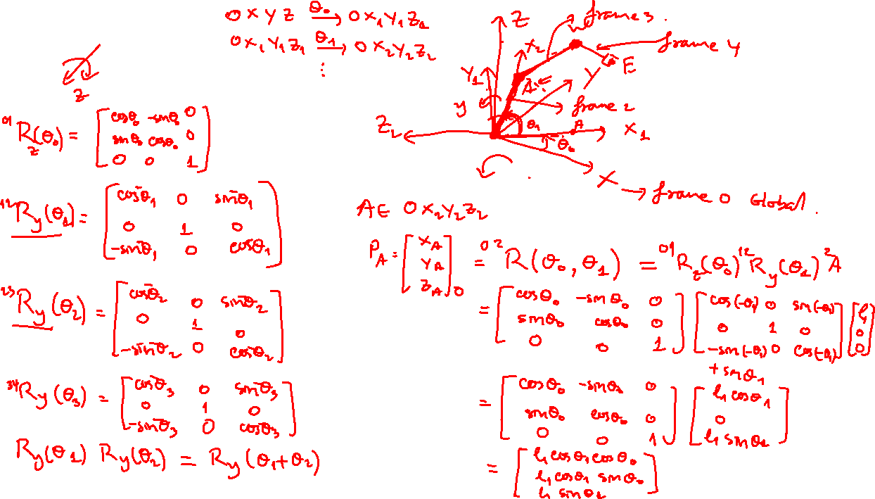

Slide 19


















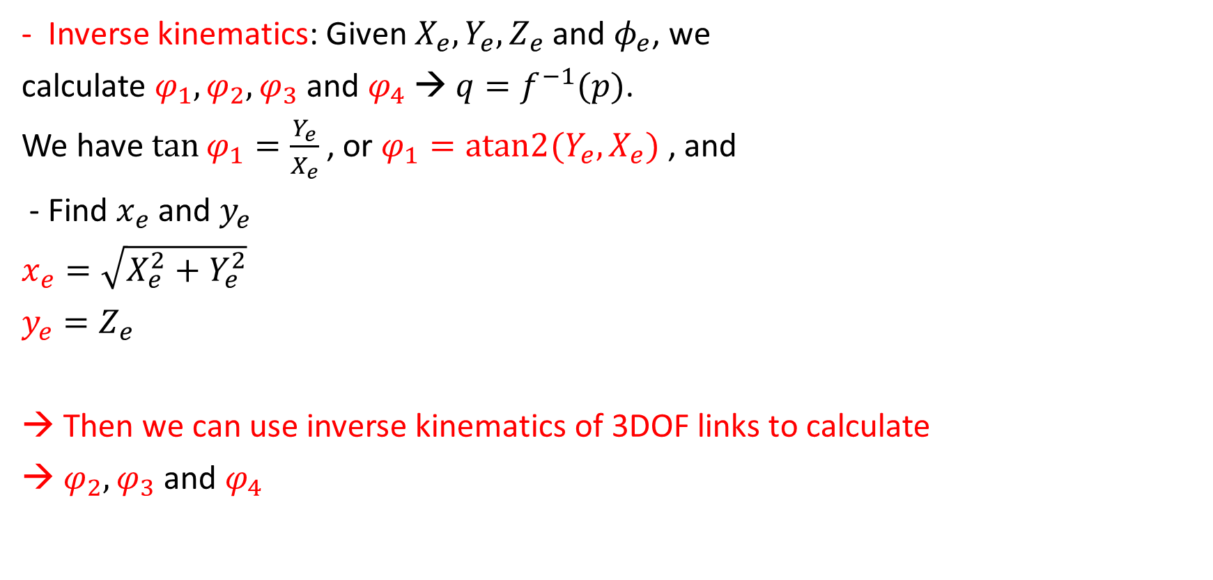


Classical Kinematics for 4DOF spatial manipulator
$$Z$$
$$y$$
Inverse kinematics: Given $X_{e}, Y_{e}, Z_{e}$ and $φ_{e}$, we
calculate $φ_{1},φ_{2},φ_{3}$ and $φ_{4}$ → $q=f^{−1}(p)$.
We have$\tan{φ_{1}}=\frac{Y_{e}}{X_{e}}$ , or $φ_{1}=atan2{(Y_{e},X_{e})}$ , and
- Find $x_{e}$ and $y_{e}$
$x_{e}=\sqrt{X_{e}^{2}+Y_{e}^{2}}$
$y_{e}=Z_{e}$
Then we can use inverse kinematics of 3DOF links to calculate
$φ_{2},φ_{3}$ and $φ_{4}$
$$W$$
$$φ_{3}$$
$$l_{3}$$
$$A$$
$$l_{2}$$
$$E$$
$$Y$$
$$l_{1}$$
$$Y_{e}$$
$$Y_{w}$$
$$φ_{2}$$
$$x$$
$$φ_{1}$$
$$x_{w}$$
$$x_{e}$$
$$X_{w}$$
$$X_{e}$$
$$X$$

Slide 20

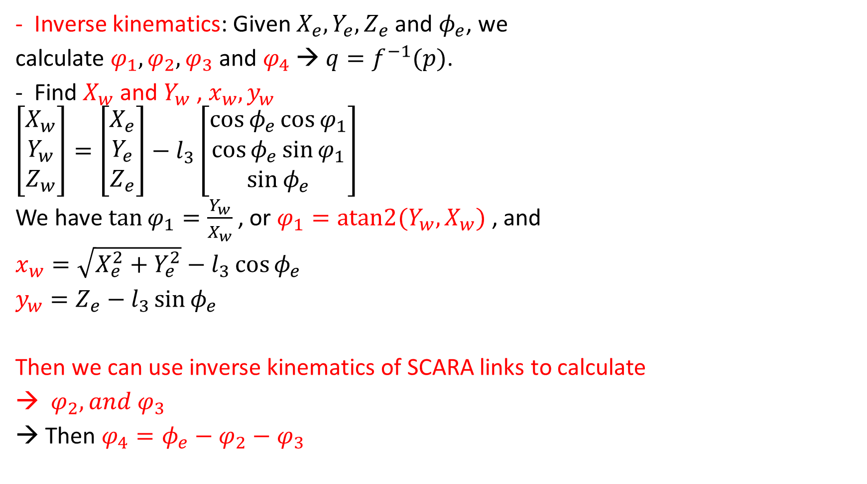

OR
Inverse kinematics: Given $X_{e}, Y_{e}, Z_{e}$ and $φ_{e}$, we
calculate $φ_{1},φ_{2},φ_{3}$ and $φ_{4}$ → $q=f^{−1}(p)$.
Find $X_{w}$ and $Y_{w}$ , $x_{w}, y_{w}$
$\left[\begin{matrix}X_{w} \\ Y_{w} \\ Z_{w}\end{matrix}\right]=\left[\begin{matrix}X_{e} \\ Y_{e} \\ Z_{e}\end{matrix}\right]−l_{3}\left[\begin{matrix}\cos{φ_{e}}\cos{φ_{1}} \\ \cos{φ_{e}}\sin{φ_{1}} \\ \sin{φ_{e}}\end{matrix}\right]$
We have$\tan{φ_{1}}=\frac{Y_{w}}{X_{w}}$ , or $φ_{1}=atan2{(Y_{w},X_{w})}$ , and
$x_{w}=\sqrt{X_{e}^{2}+Y_{e}^{2}}−l_{3}\cos{φ_{e}}$
$y_{w}=Z_{e}−l_{3}\sin{φ_{e}}$
Then we can use inverse kinematics of SCARA links to calculate
$φ_{2}, and φ_{3}$
Then $φ_{4}=φ_{e}−φ_{2}−φ_{3}$
$$Z$$
$$y$$
$$W$$
$$Y$$
$$φ_{3}$$
$$l_{3}$$
$$A$$
$$l_{2}$$
$$E$$
$$l_{1}$$
$$Y_{e}$$
$$Y_{w}$$
$$φ_{2}$$
$$x$$
$$φ_{1}$$
$$x_{w}$$
$$x_{e}$$
$$X_{w}$$
$$X_{e}$$
$$X$$

Slide 21
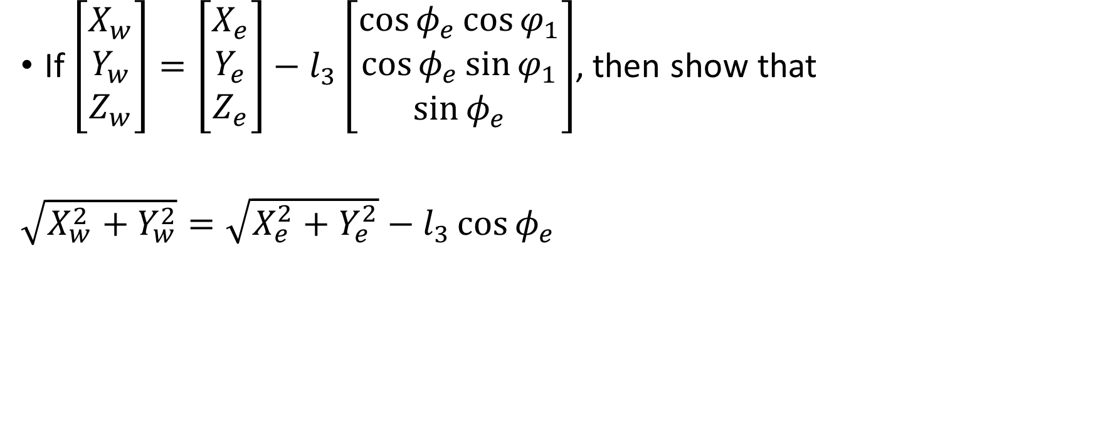



Exercise
If $\left[\begin{matrix}X_{w} \\ Y_{w} \\ Z_{w}\end{matrix}\right]=\left[\begin{matrix}X_{e} \\ Y_{e} \\ Z_{e}\end{matrix}\right]−l_{3}\left[\begin{matrix}\cos{φ_{e}}\cos{φ_{1}} \\ \cos{φ_{e}}\sin{φ_{1}} \\ \sin{φ_{e}}\end{matrix}\right]$, then show that
$\sqrt{X_{w}^{2}+Y_{w}^{2}}=\sqrt{X_{e}^{2}+Y_{e}^{2}}−l_{3}\cos{φ_{e}}$
$$Z$$
$$y$$
$$W$$
$$Y$$
$$φ_{3}$$
$$l_{3}$$
$$A$$
$$l_{2}$$
$$E$$
$$l_{1}$$
$$Y_{e}$$
$$Y_{w}$$
$$φ_{2}$$
$$x$$
$$φ_{1}$$
$$x_{w}$$
$$x_{e}$$
$$X_{w}$$
$$X_{e}$$
$$X$$

Slide 22
Algorithm f4dof: Forward kinematics for 4DOF Robot

Slide 23
Algorithm i4dof: Inverse kinematics for 4DOF Robot

Slide 24
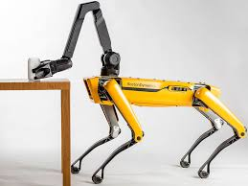
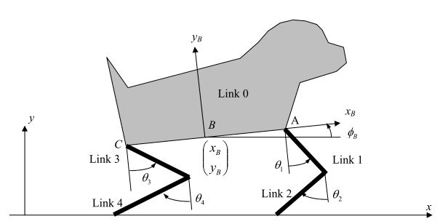
Almost enough knowledge of kinematics for use with this kind of robot!!!
The arm has
4 DOF + 1 DOF of
end-effector twist
Each leg has spatial 3 DOF

